Slide 1

Version control, git, and GitHub
EPH Lunchtime hacks, June 29th 2021
Carlos Valencia-Hernández

Slide 2
Outline
Version control, git, GitHub
Frequently used terms
GitHub in Mac/Windows
Integration with R?

Slide 3

VERSION CONTROL

Slide 4
What is git?
“A free and open source distributed version control system designed to handle everything from small to very large projects with speed and efficiency”
https://git-scm.com/

Slide 5

Version control
Record changes over time
Management of changes to documents, programs, web sites, or any other information
Snapshots of every change you make
Revert changes if needed

Slide 6
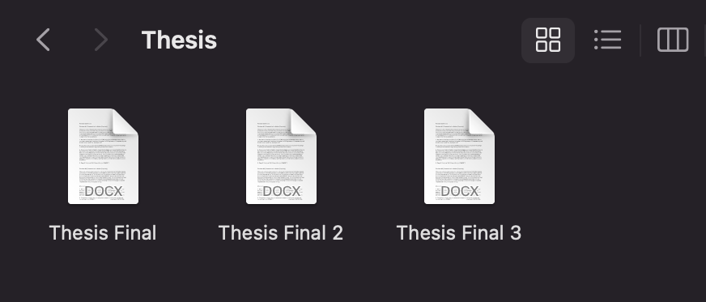
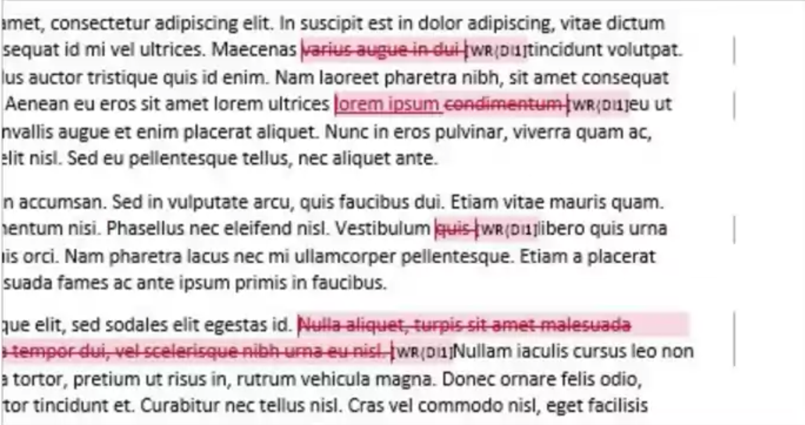


Track changes in MS Word

Slide 7
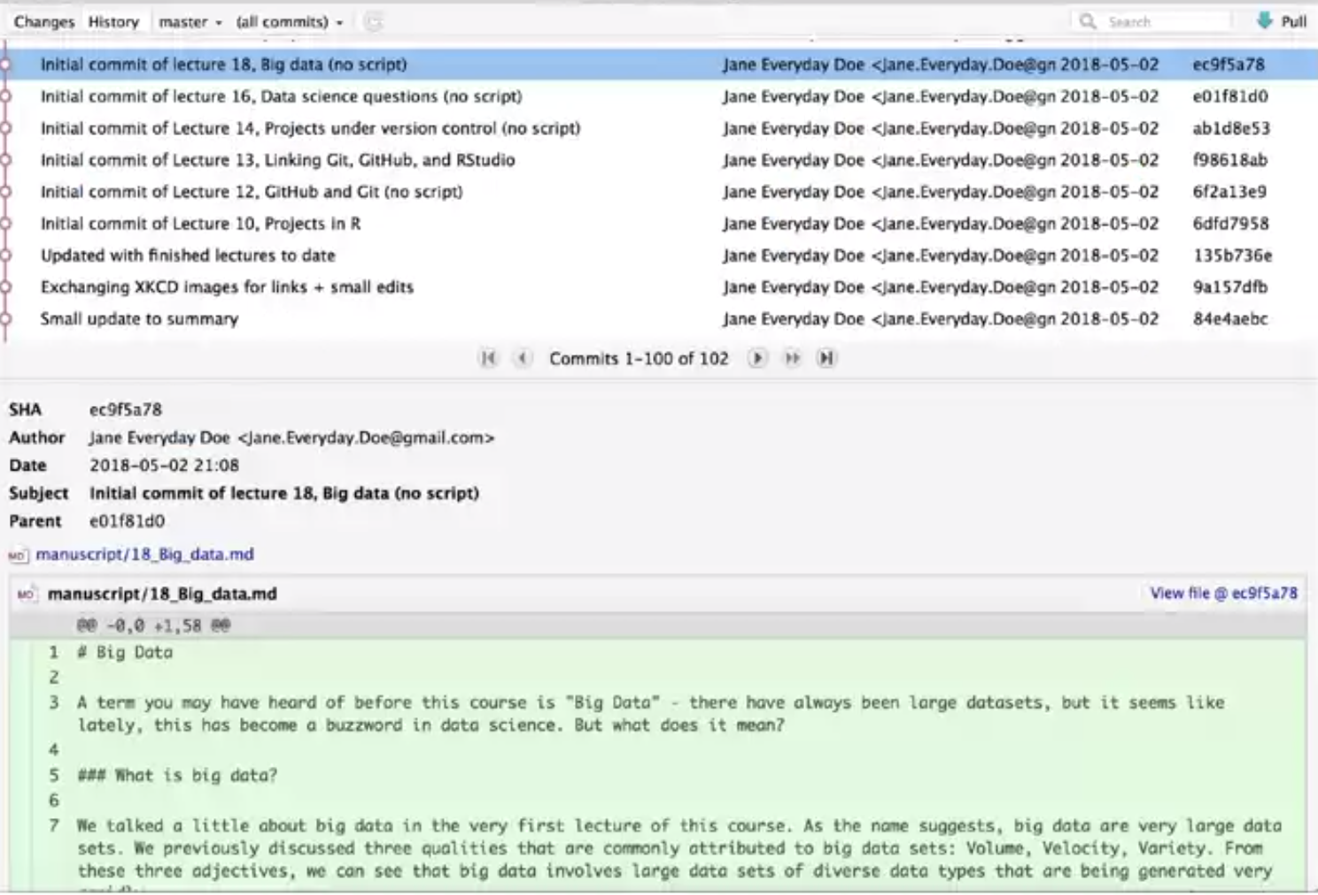

Slide 8
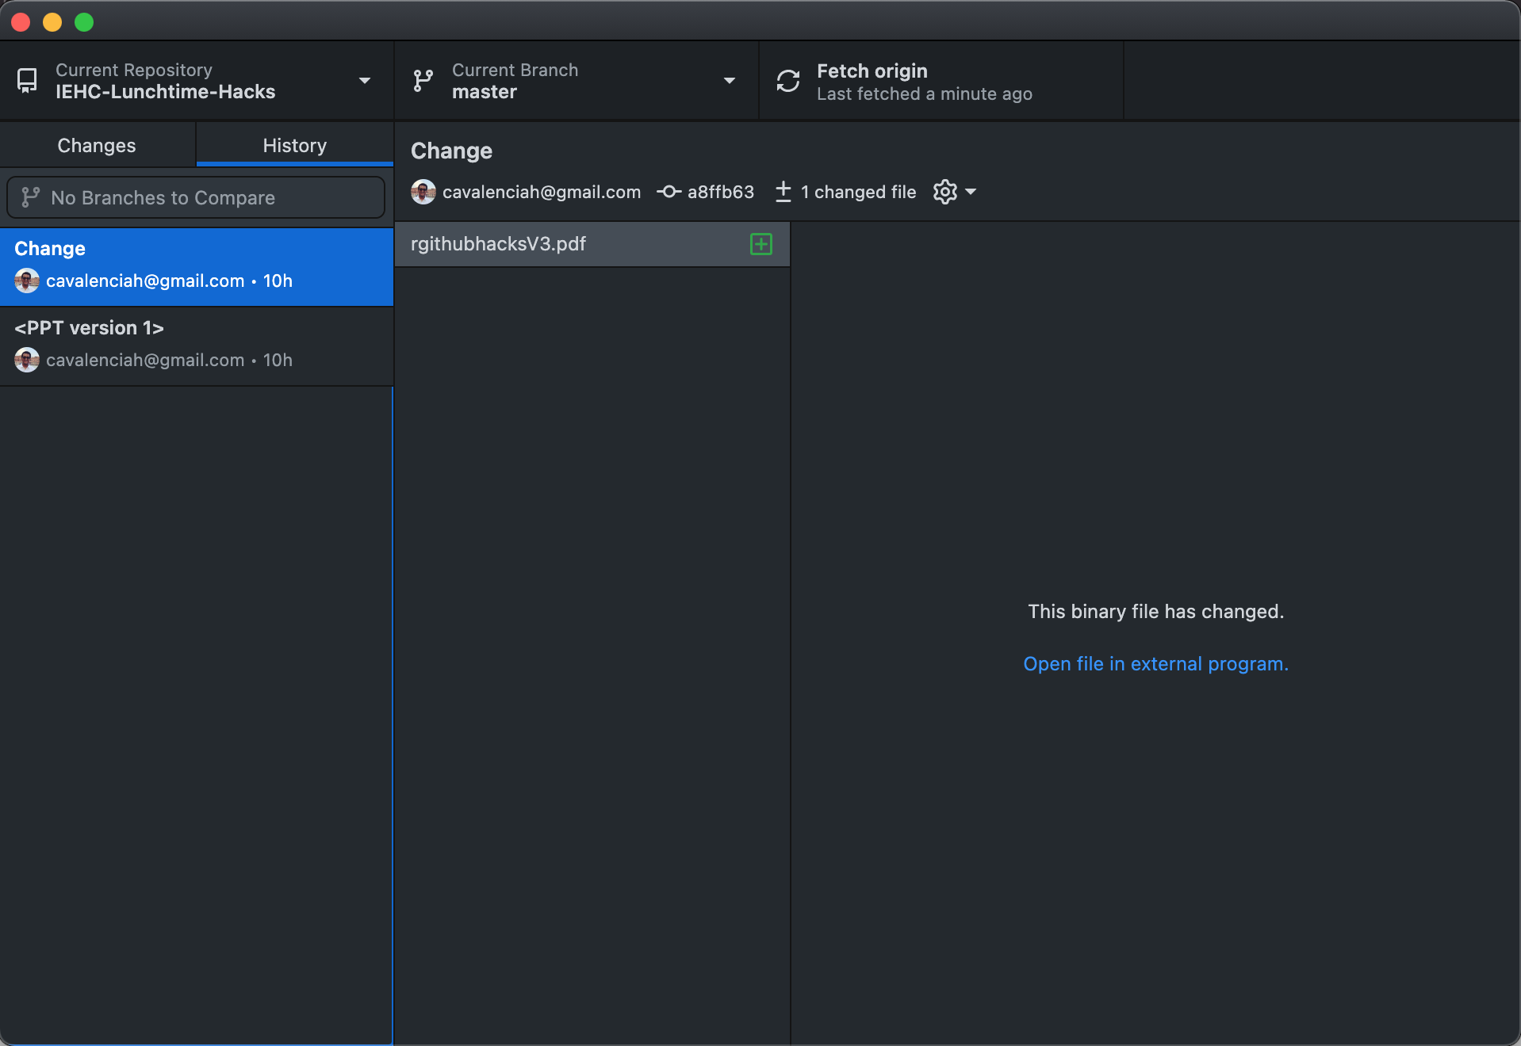

Slide 9






Online version control?

Slide 10
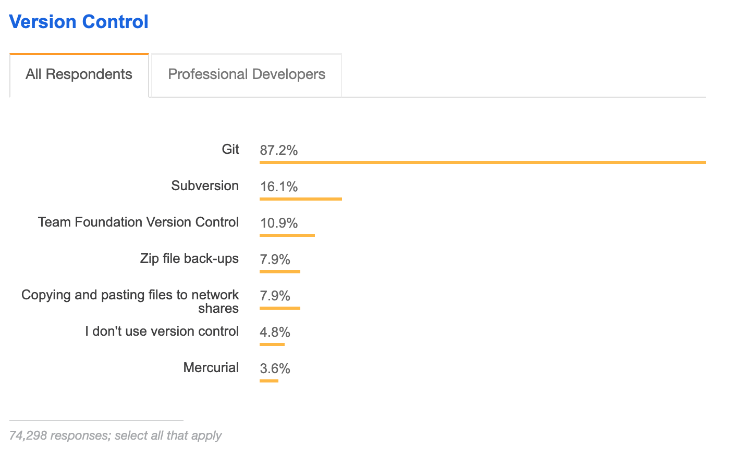
https://insights.stackoverflow.com/survey/2018#development-practices

Slide 11
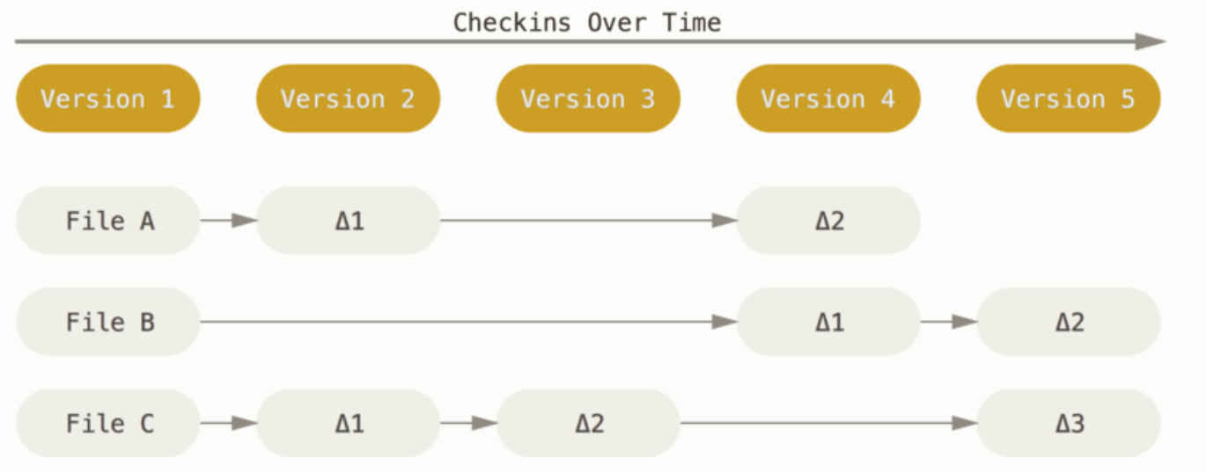
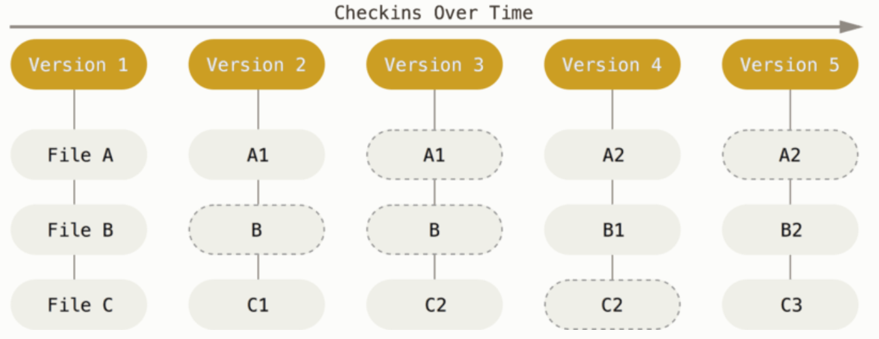
Snapshots, not differences
Other version control software
Git (snapshots)

Slide 12




Frequently used terms
Repository
A folder that contains a project. (Although you can have multiple projects inside a repository)
Commit
Each snapshot or version of the project (locally)
Branch
A sequence of commits that has an order. (A Master branch)
Push
Pull

Slide 13
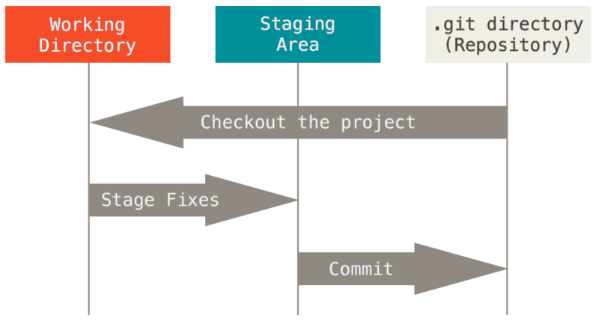
Main sections of a Git project
(PULL)
PUSH
https://git-scm.com/book/en/v2/Getting-Started-What-is-Git%3F

Slide 14
Branches
Files with two copies that are simultaneous
Merge
Local “B” branch
Repository
Main branch
Merge
Local “A” branch
Commits

Slide 15
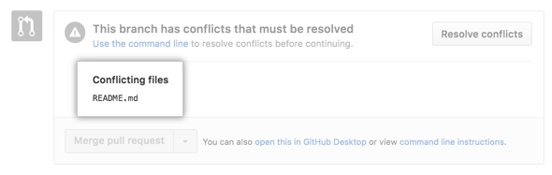
Conflict
Merging branches with competing commits
Local “B” branch
Repository
Main branch
Conflict
Local “A” branch
Commits

Slide 16



clone
localgithub/repository
branch
github/repository
PULL REQUEST-→ OWNER
github/repository
fork
mygithub/repository

Slide 17
What is Git(Hub?)
The GitHub
Open source program for version control
Multiple programming languages (Also Stata)
The GitHub
A collaboration platform
Showcase
Repository

Slide 18
Most popular languages on GitHub
Place | Language | %
1 | JavaScript | 18.756% (+0.053%)
2 | Python | 16.628% (+0.390%)
3 | Java | 11.680% (+0.742%)
4 | Go | 7.829% (-1.176%)
5 | Ruby | 7.588% (+0.776%)
6 | C++ | 6.985% (-0.439%)
7 | TypeScript | 6.604% (-0.164%)
8 | PHP | 5.081% (-0.046%)
9 | C# | 3.614% (-0.221%)
10 | C | 3.253% (+0.072%)
33 | R

Slide 19
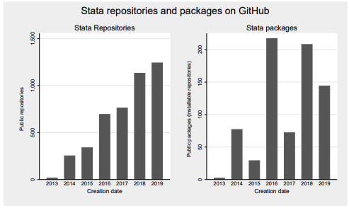
Growing popularity of Stata in GitHub
http://www.haghish.com/resources/pdf/github.pdf

Slide 20


Slide 21
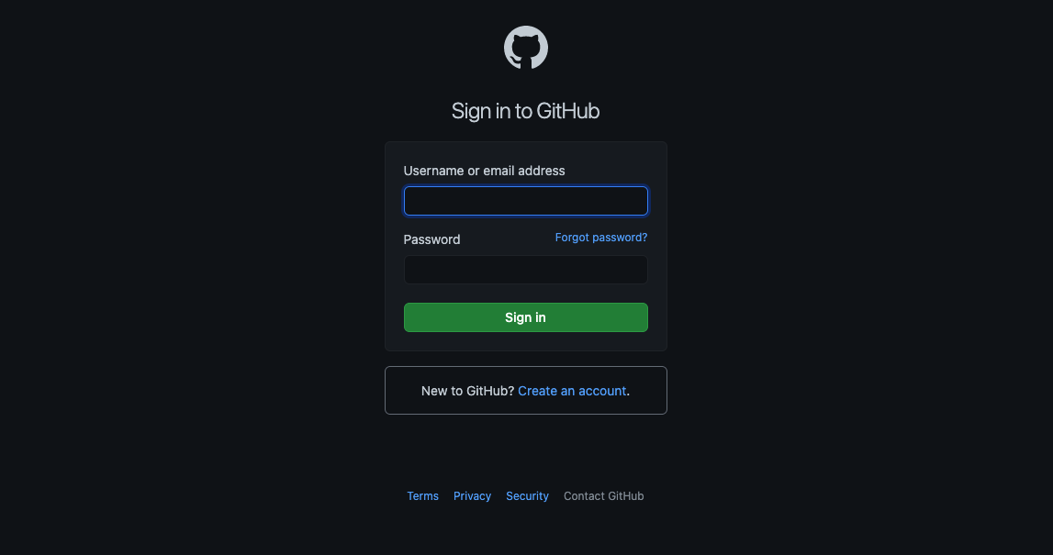

Slide 22
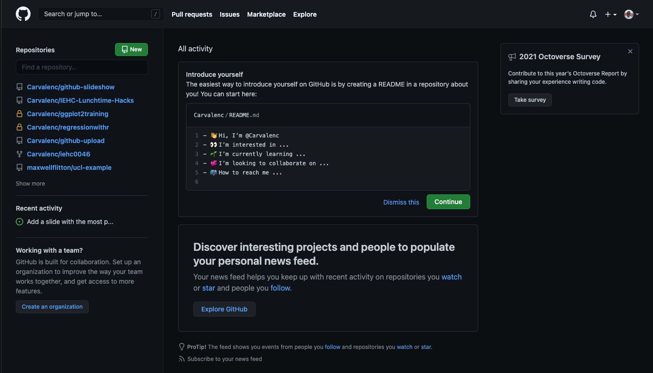
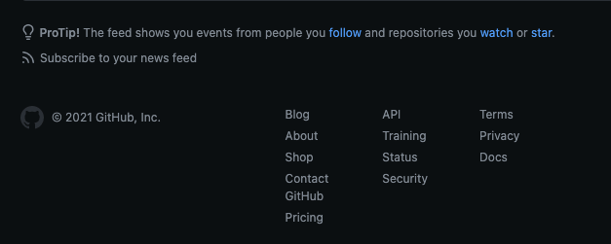
Notifications
User settings
Help files

Slide 23
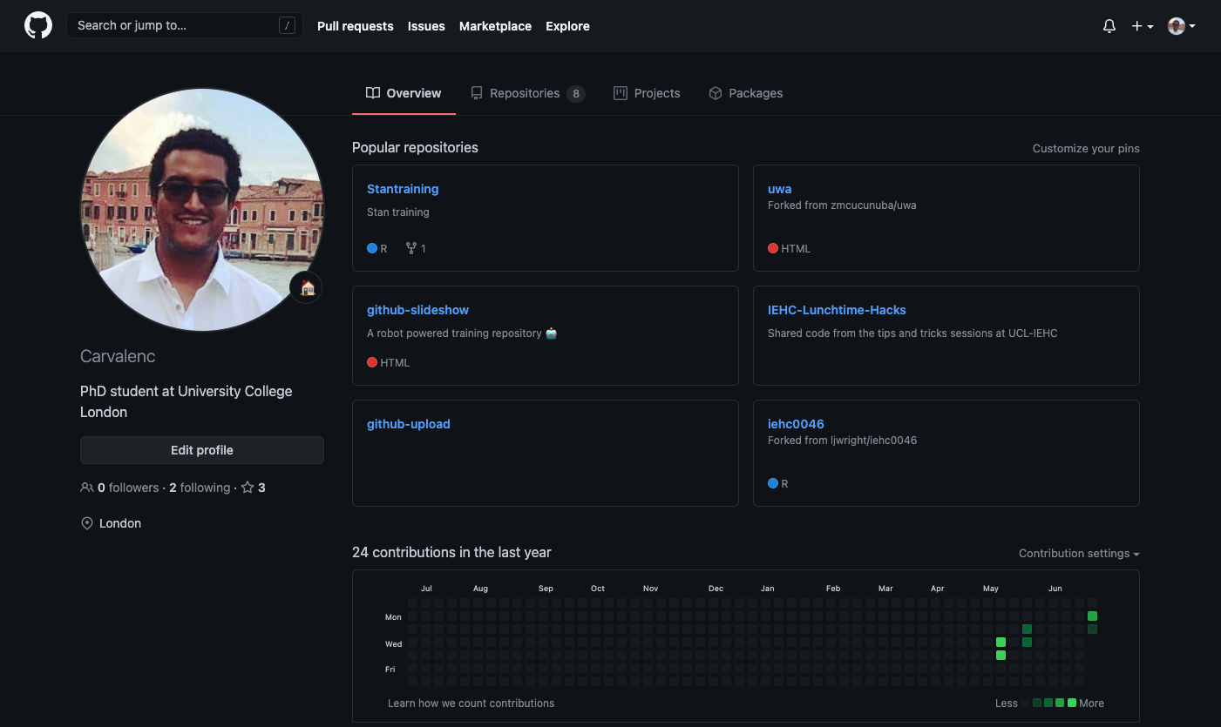

Slide 24
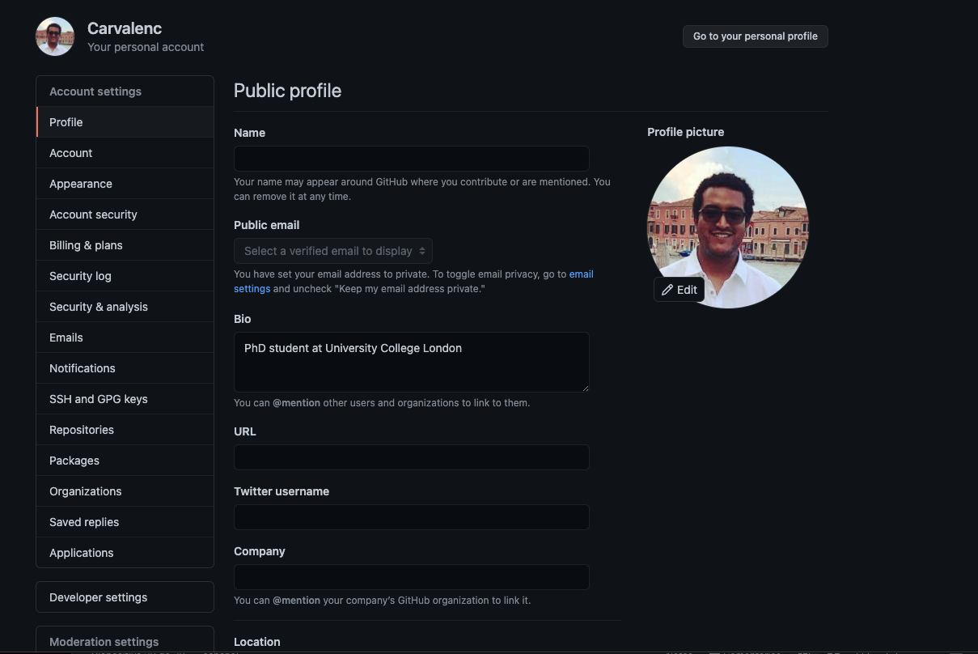

Slide 25


Slide 26
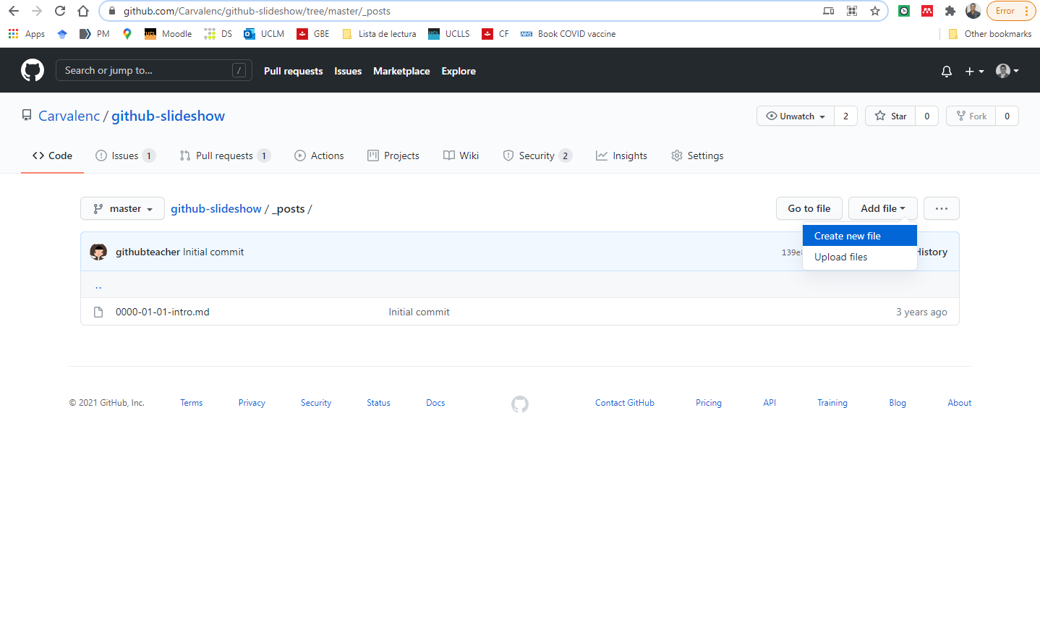

Slide 27
Pull request
Propose a work in progress to be pulled into the project

Slide 28
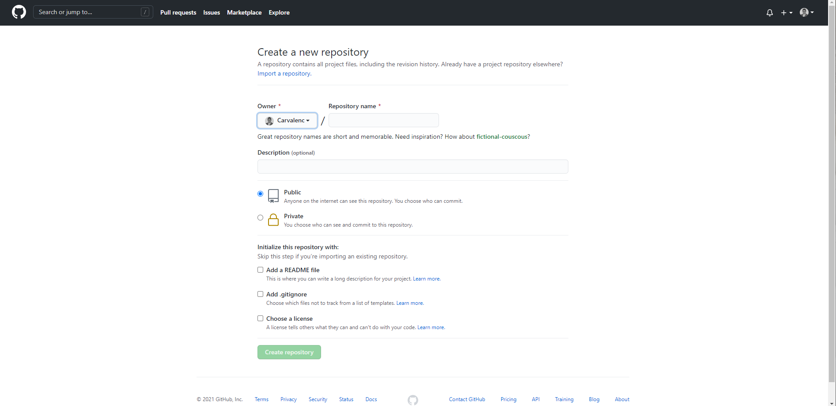
Creating a new repository

Slide 29
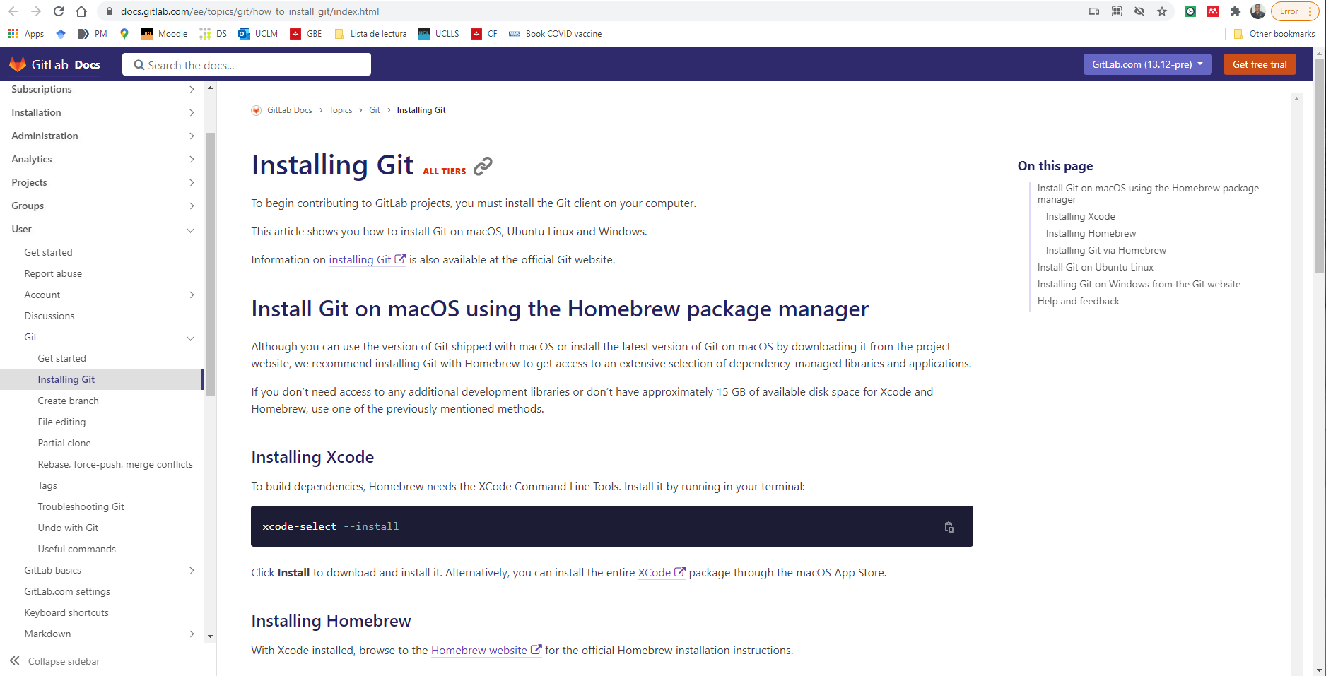

Slide 30
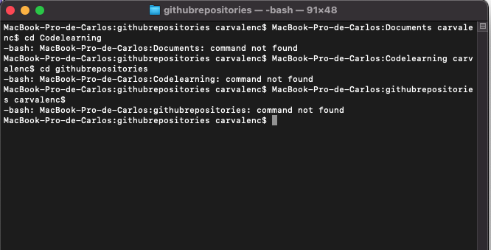
MAC terminal

Slide 31
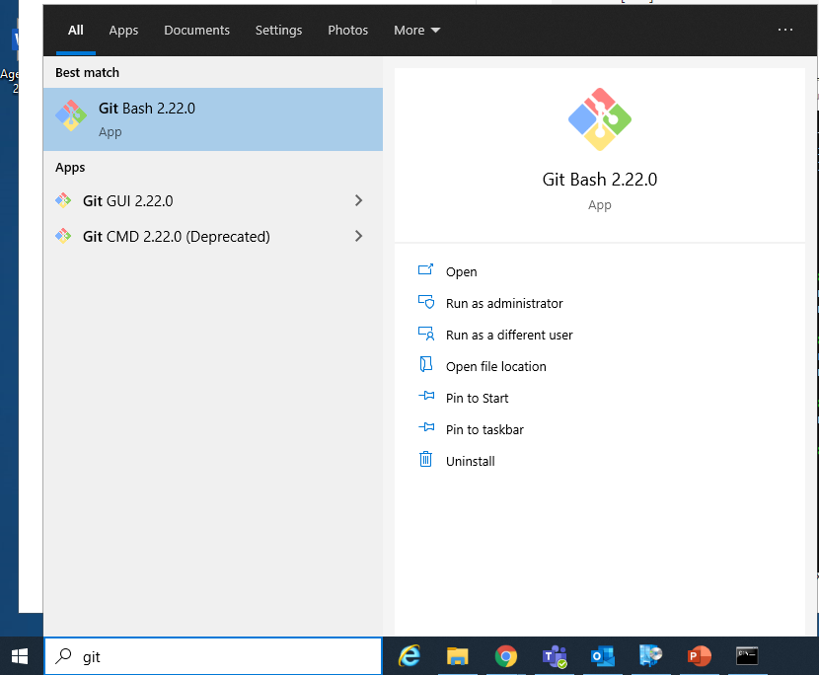
Windows on a UCL computer

Slide 32
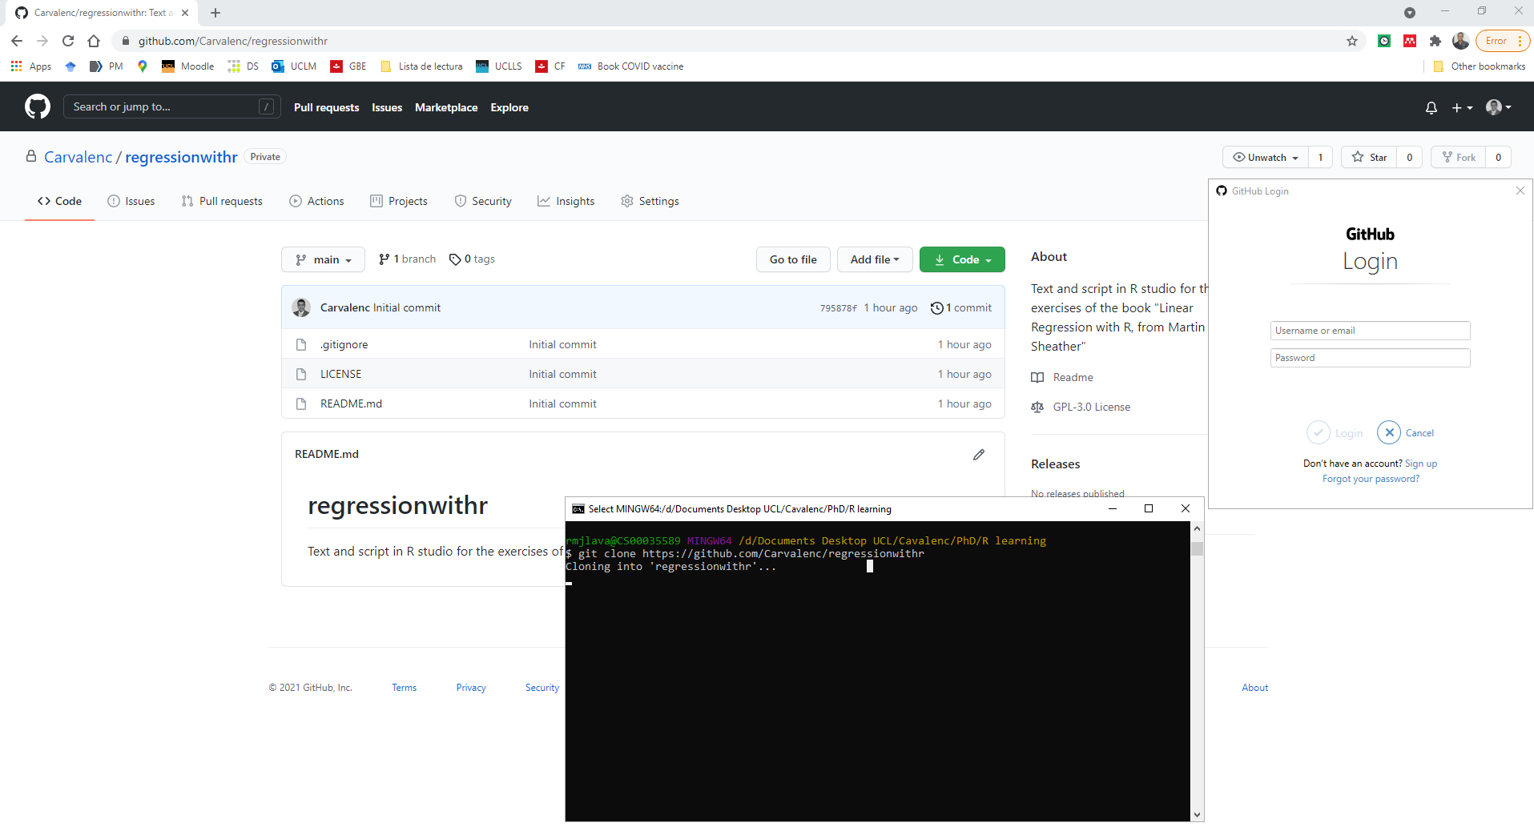
Clone the repository

Slide 33
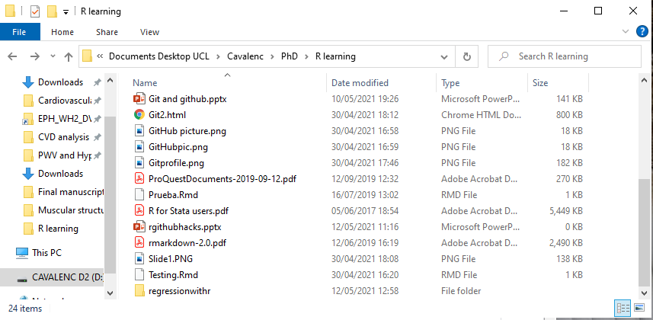
Now we can see the cloned repository

Slide 34
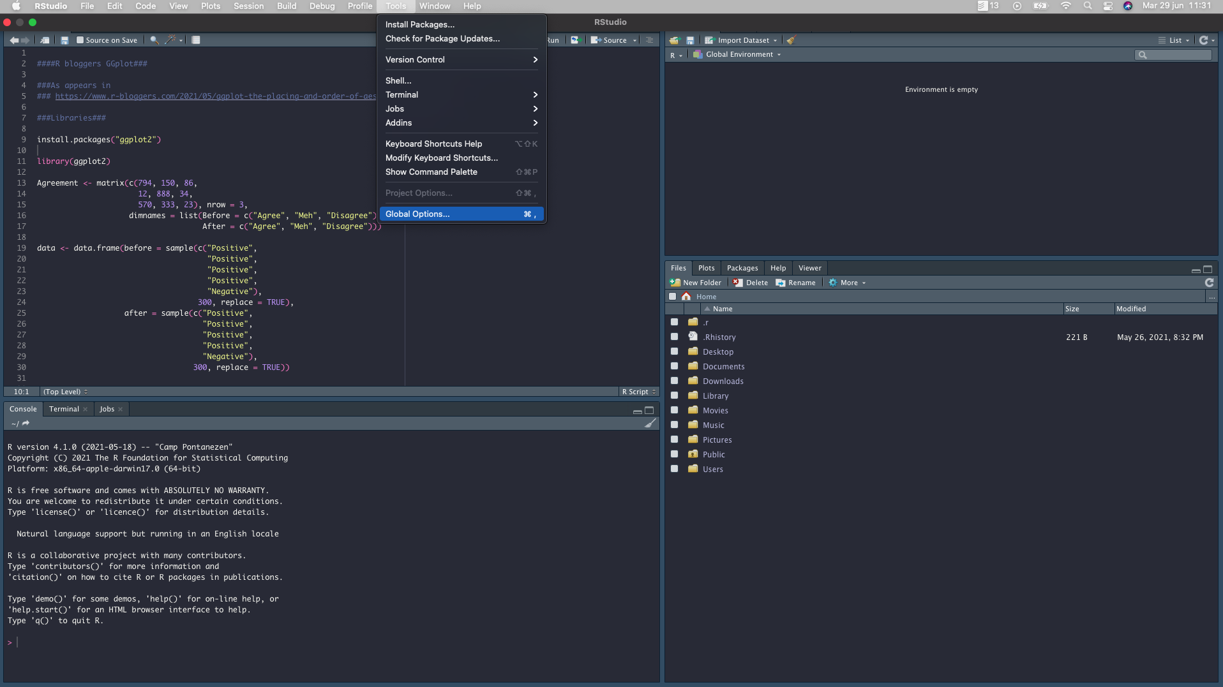
Linking Github and R Studio

Slide 35
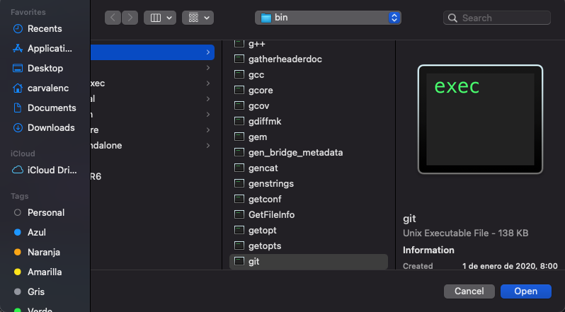
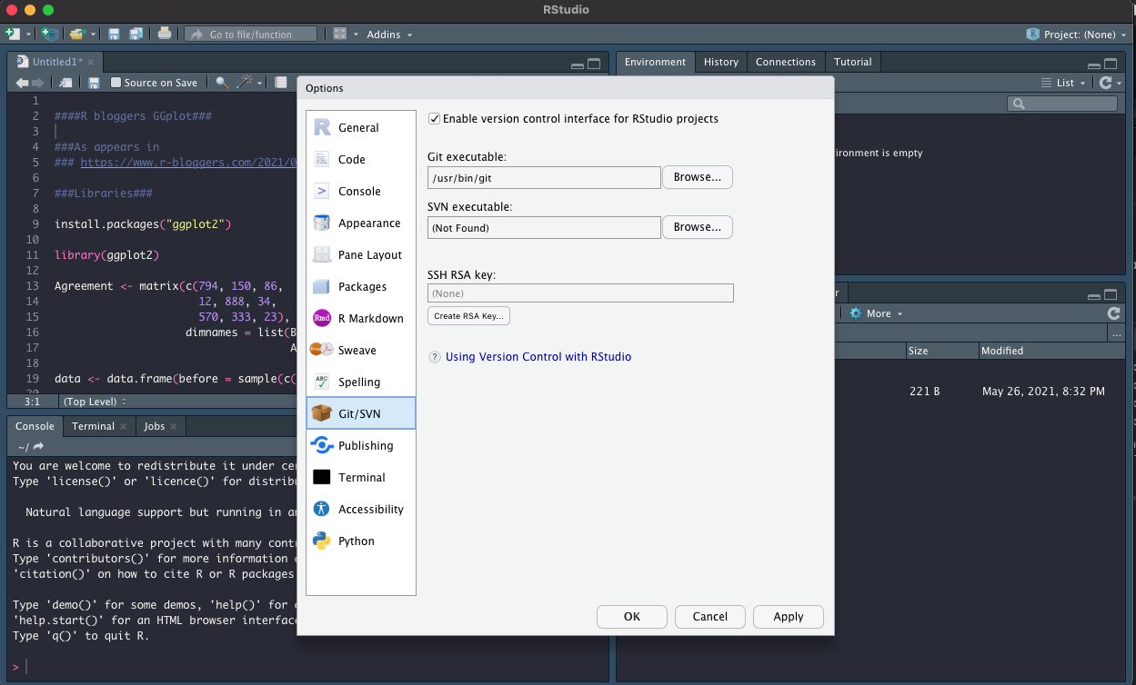

Slide 36
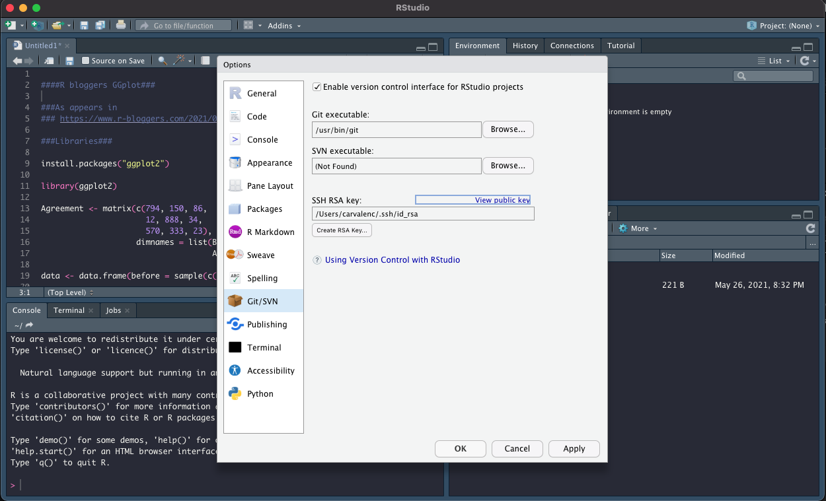

Slide 37
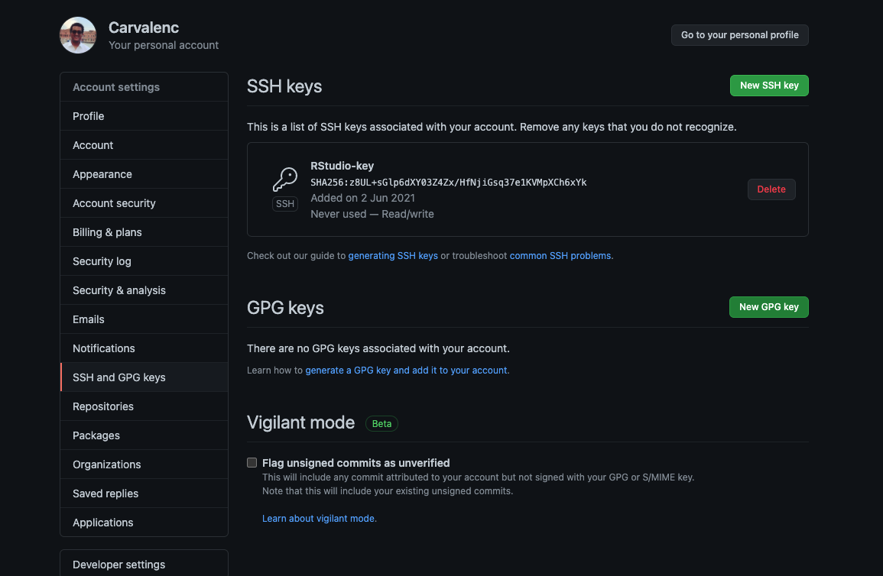

Slide 38
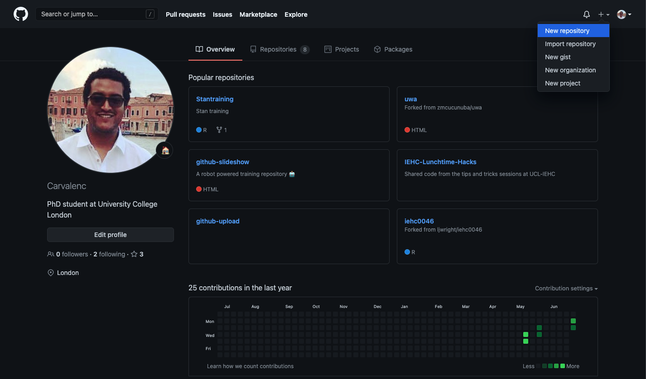
Then we create a new repository

Slide 39
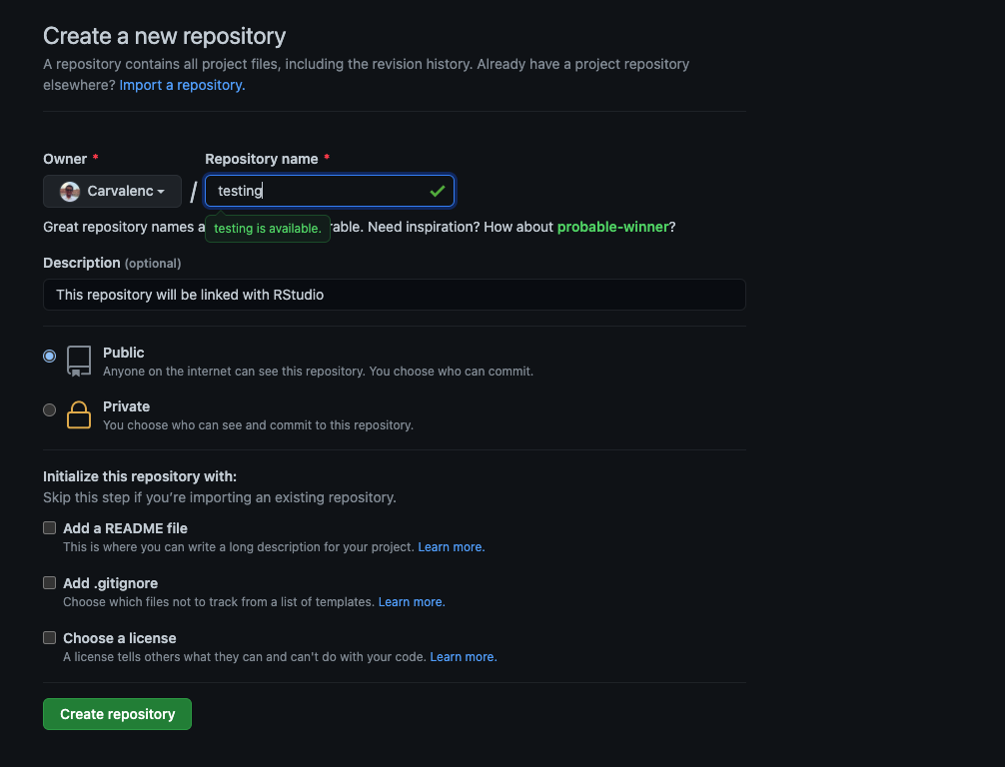

Slide 40
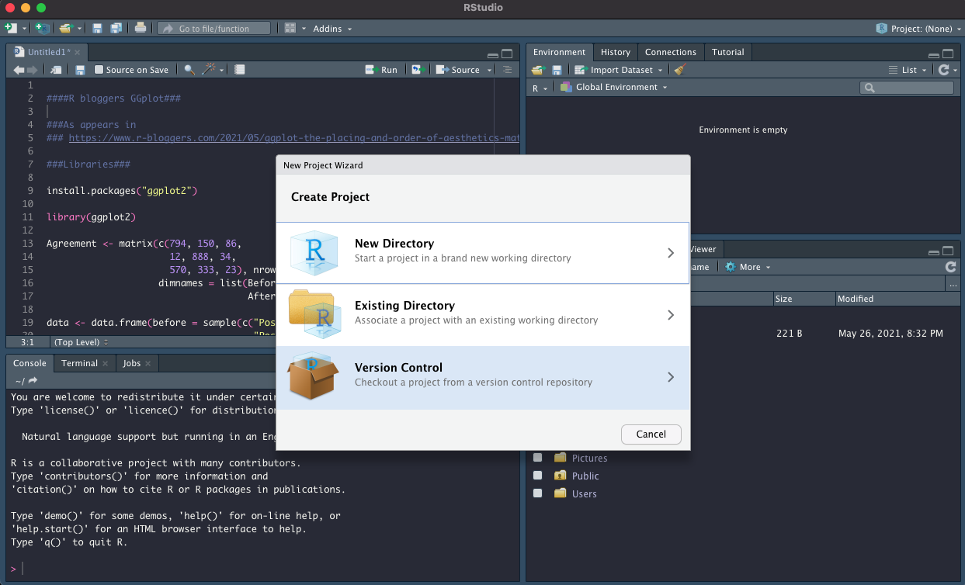

Slide 41
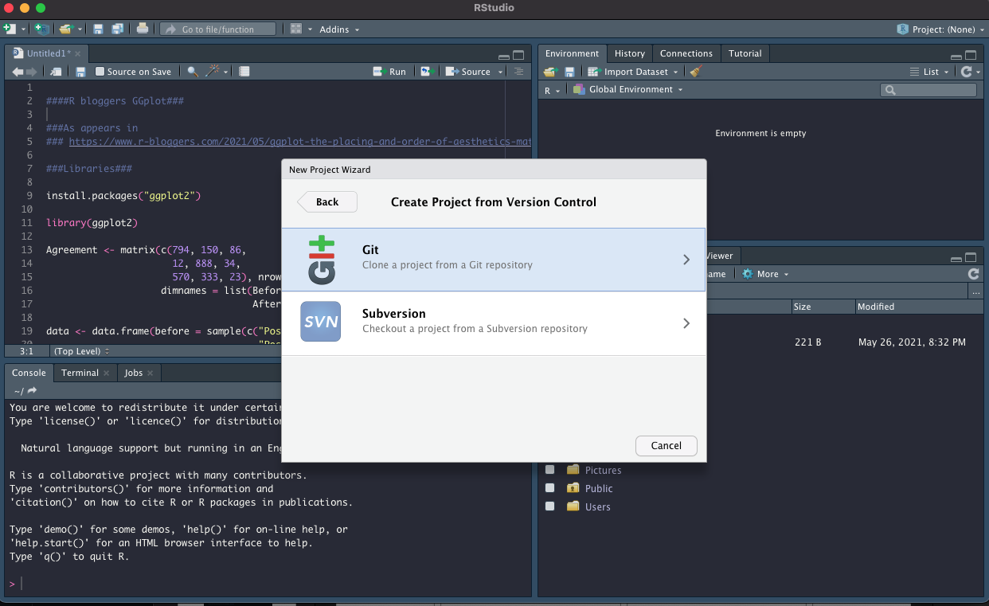

Slide 42
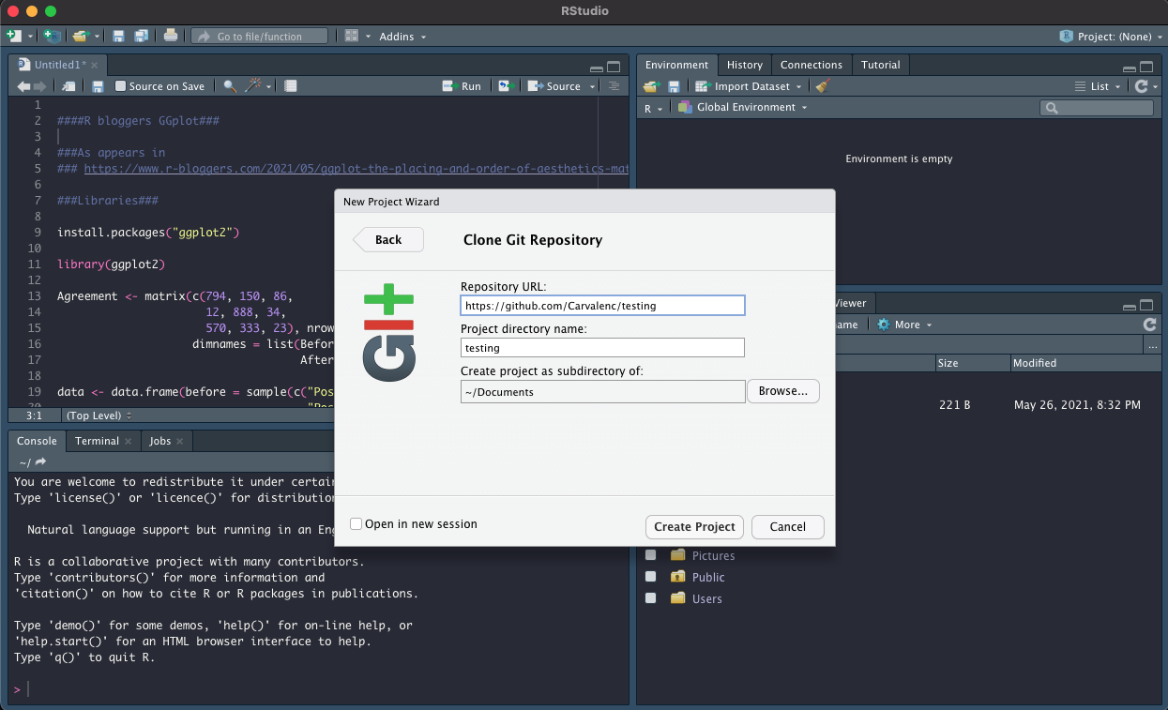

Slide 43
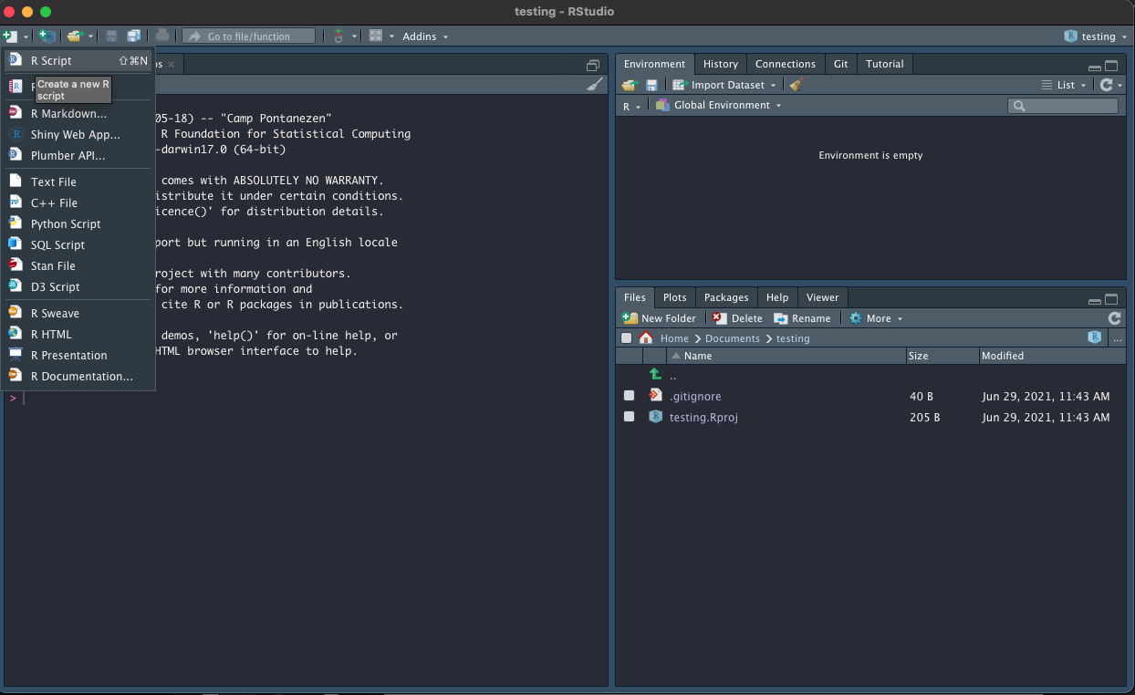

Slide 44
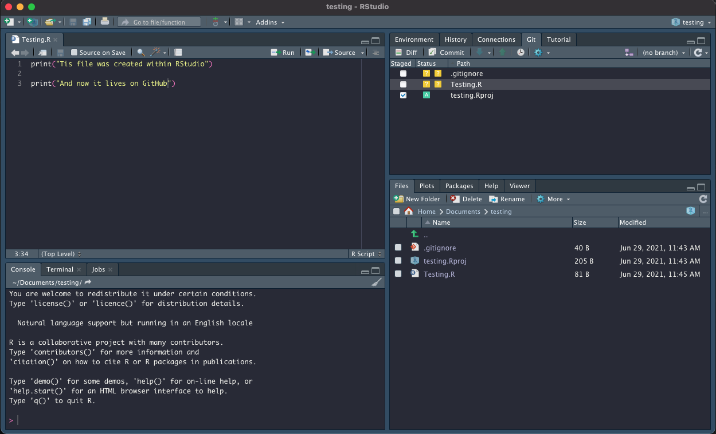

Slide 45
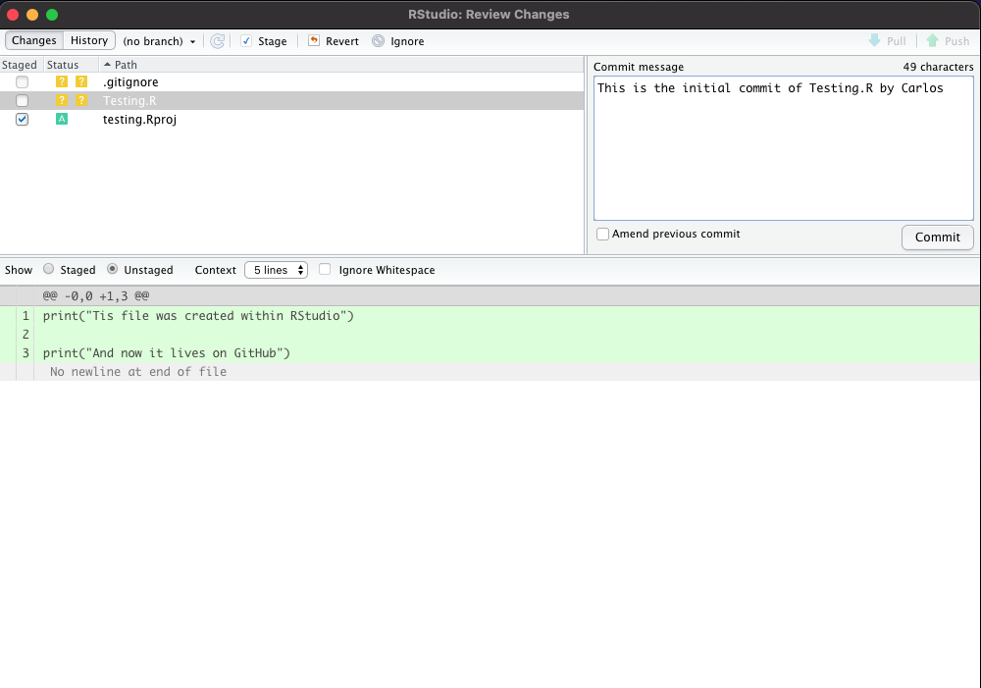

Slide 46
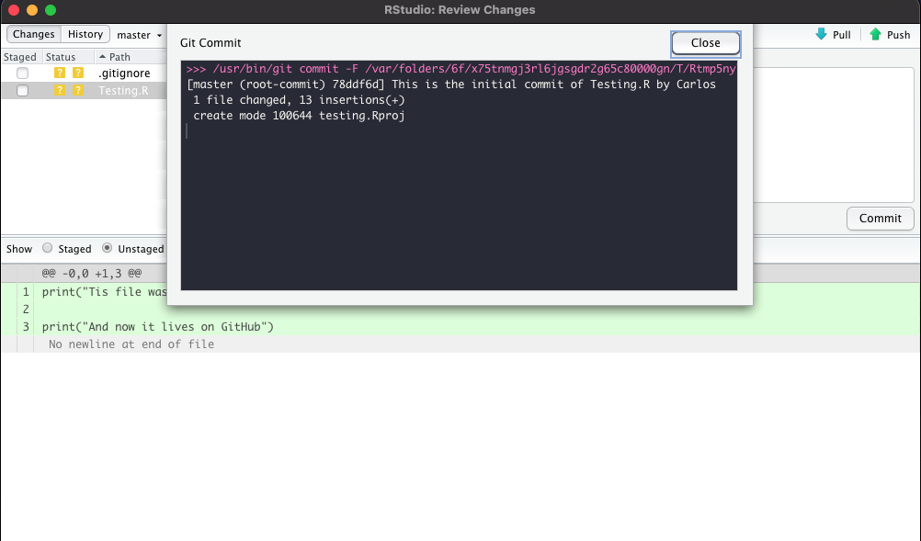

Slide 47
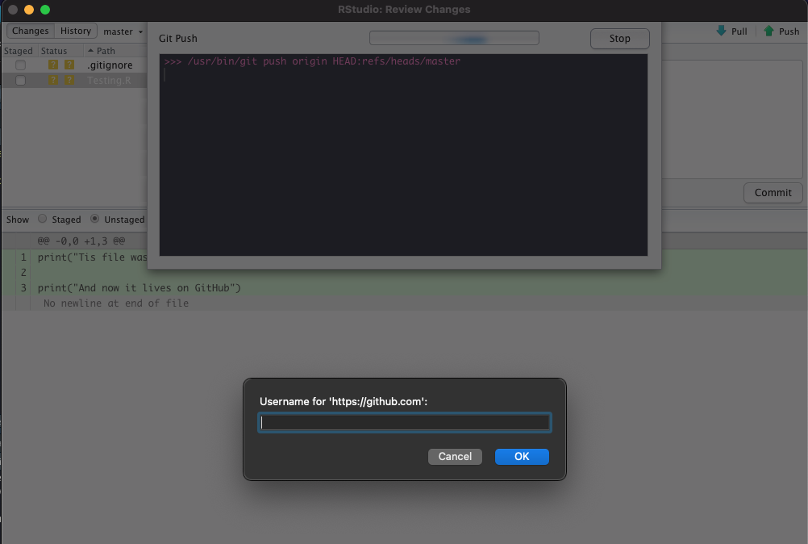

Slide 48
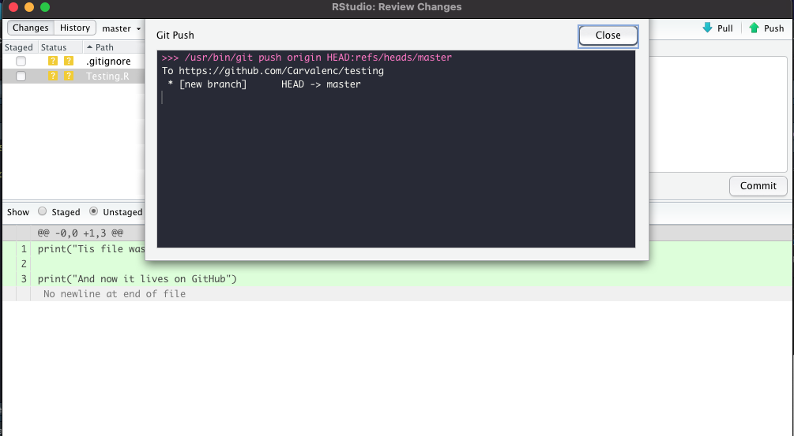

Slide 49
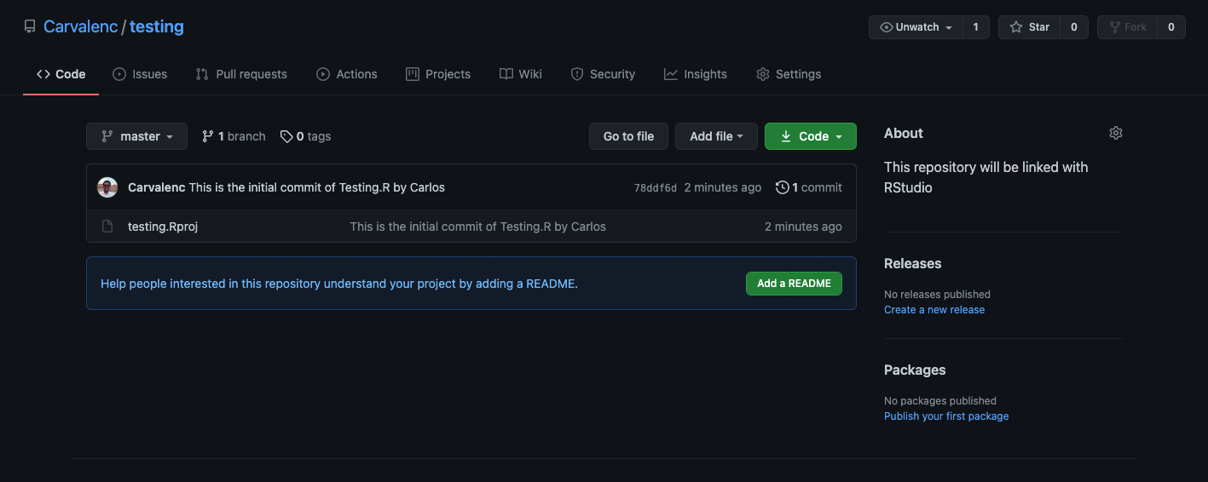

Slide 50

Useful resources:
The Git book
https://git-scm.com/book/en/v2
Set up Git course
https://docs.github.com/en/get-started/quickstart/set-up-git

